Slide 2
Prior Work
Total latency = Computational latency + Communication latency
Prior works (DeepMon [Mobisys’17], Mcdnn [Mobisys’16]) focuses optimizing Computational latency only using some local scheduling algorithms
Notes:
Prior works (DeepMon [Mobisys’17] using HW accelerator in the form of GPU, Mcdnn [Mobisys’16] how to schedule heterogeneous requests in a resource constraint environment) focuses optimizing computational latency only using some local scheduling algorithms.
This motivates the need for self driving network. Where when the application is performing bad react to those situations and improve the user experience.
Current methods of enhancing the application performance static, unresponsive to network changes and don’t consider real user exp

Slide 3
Observations → Where is the Bottleneck?
But for remote execution,
communication time >> computation time
Network condition can be heavily shifted
decrease by 10.33 times during peak hours for LTE
This variation would affect most for edge device – edge server communication (last hop)
Edge devices have resource constraint
Drain out battery rapidly while computation-intensive DNN tasks
Notes:
18.65 for WiFi hotspot (Network condition)
Finding where is the bottleneck?

Slide 4
Why Local-Remote Execution is not a Good Solution?
Consider a local model is currently being used and net BW got improved and system decides to offload
But net BW increased temporarily, it may be suboptimal to switch due to cost overhead
Suboptimality in network BW and time dynamics

Slide 5
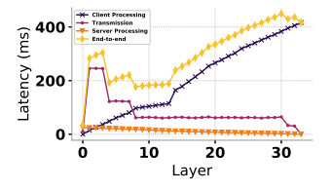
Why Partitioning DNN not a good solution?
Intermediate output of a CNN model such as feature maps 10X than inputs
Client-side latency and communication overhead keeps on increasing
For Resource-constraint end devices (drones), remote execution seems to be the best solution with availability of network BW
Notes:
Either offload completely or execute completely locally

Slide 6
Why cloud processing is the best?
It will keep the model private as opposed to Federated learning
Cloud based approaches provide benefits such as centralized model management and ability to execute deeper and more complex CNN models

Slide 7
What state of the art doing?
As running object detection in each frame is very costly hence recent papers use object tracking in each frame with occasional object detection.
First do the object detection get a list of images then track those list of images before next object detection triggers
Problem: If new object appears and system is not taking care of then it will remain undetected for next set of frames (this is problematic for drones)

Slide 8
What’s the difference with ModiPrep?
Modiprep talks about cloud-based CNN-inference
only image classification
End-2-end inference time varies depending on input size and network condition
How pre-execution time reduction (pre-processing the input) trades of with detection accuracy
When, how and where to preprocess the input?
Where is not a valid question to ask as resolution of recording devices are increasing and we can’t upload the high-resolution raw frame.
Notes:
Latency constraint ~ 500 ms

Slide 9
Things not considered……
ModiPrep focuses only on image classification of JPEG which is much simpler
Their baseline starts with the lossy
It doesn’t talk about the interplay of different content reduction algorithm and how they impact the accuracy
Their target size only dependent on network behavior not on video content contrast to Adascale?
Uses linear regression models
Mobile preprocessing + network tx time → modelled on mobile
Cloud preprocessing → modelled on server
They didn’t consider multiple different models depending on the network conditions

Slide 10
Problem Statement
How to get the best possible detection accuracy under different network conditions given a time constraint for a real-time CNN-based object detection application?

Slide 11
Two Tunable Inputs
Video content
CNN Model
How to adjust the Computation time according to the Communication time ??

Slide 12
Now, how to adaptively reduce network BW requirement based on input video content???

Slide 13
Design Choice I: Resizing the Image
Scaling
Cropping
Seam Carving
AdaScele [sysML’19] only focuses on downsample size, this parameter is used as a tuning parameter in multiple other papers
Notes:
Adascle comes to the observation that downsampling could reduce noises and can reduce false positives so how to determine how much each image to scale to improve the accuracy.
They didn’t use the downscaling as a trade off parameter for accuracy and speedup.

Slide 14
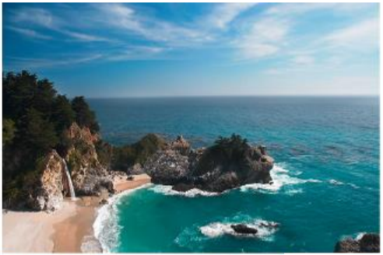
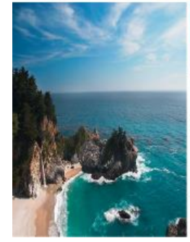
Scaling
Introduce linear global distortion

Slide 15
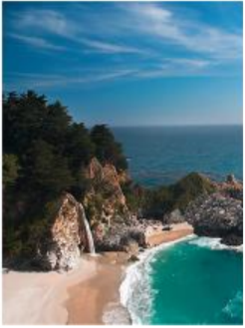
Cropping
May remove important parts

Slide 16
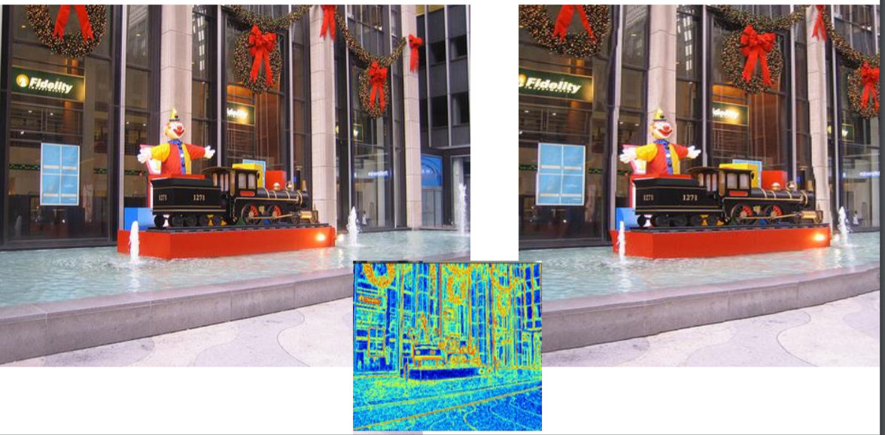
Seam Carving
(content aware scaling)
Time Consuming
Seam: Remove the vertical curve of lowest energy
Notes:
Any paper does this?

Slide 17
Design Choice II: Drop Unnecessary Frames
Sample Video at different (lower) frequencies
But not good for high motion videos with less temporal locality
Based on video temporal locality and available net BW propose an ML model to predict the frequency

Slide 18
Design Choice II: Compression (Encoding + Decoding)
Appropriate bitrate and QP selection based on network BW
Edge Assisted Real-time Object Detection for Mobile Augmented Reality [Mobicom’19] uses encoding and decoding
but is not adaptive
Here we can train an ML model which selects appropriate QP and Video bit-rate based on network BW

Slide 19
Assumption about Network BW
Condition of wireless link is highly dynamic and unstable
But for a small time period, its almost stable
Entire network bandwidth needs to be fully utilized

Slide 20
How to estimate Network BW?
Linear regression model
T = ax + b (a = throughput, b = RTT between client and server)
Use multiple linear regression models is better than using one
Search space reduced to O(3n) from O(n³)

Slide 21
How to Classify Video Contents
Spatial locality Index (vid_{spatial})
Temporal locality Index (vid_{temp})

Slide 22
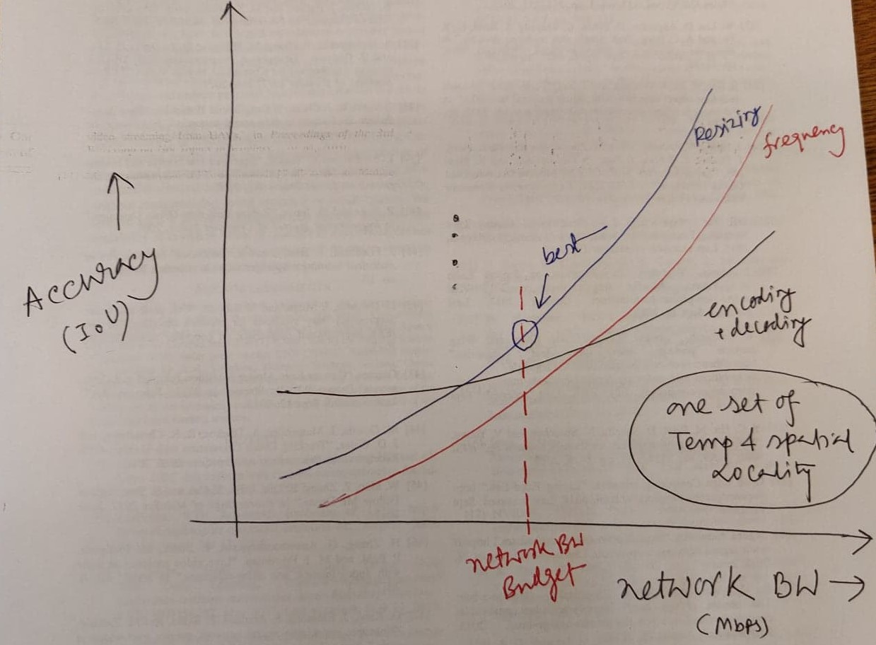
Expected Results
We can multiple of these three curves based on different video content features
Given a network BW budget, find out which way of content size reduction is efficient in a content aware manner

Slide 23
Prime Assumptions
For remote execution, communication time >> computation time
Hence total latency is dominated by communication latency
Network BW variation captures the communication latency

Slide 24
Why Cropping is not Included?
For single object of interest, a cat takes less than 15 percent in an image and background takes rest of it
RoI (Region of Interest) cropping will be a good choice then
But for multiple object detection, multiple RoI boxes can take 80-90% of the large image
RoI cropping will be insignificant
But its still can be used as an orthogonal method with any of this techniques

Slide 25
System Design I
1st component
2nd component
Small Video Segments
Extract Video Content Features
Yes/no
Scaling
Lightweight ML Classification
(vid_{temp}, vid_{spatial})
Frequency
Yes/no
Yes/no
Enconding
Network BW Budget (B)

Slide 26
System Design II
For each of three techniques, we will design a ML regression model to find the optimum value either for
Resizing parameter for scaling
frequency of offloading
quantization parameter for encoding
Model pool
Model₁ , Model₂ , Model₃
Depending predicted technique
ML Regression model_{i}
(vid_{temp}, vid_{spatial})
Optimum Value used
3rd component
Network BW Budget (B)

Slide 27
Conclusion
Remote execution is the best possible choice under a
Highly resource constraint edge devices
Limited Network BW and its variability over time make it difficult to upload high-resolution video content frequently
Three existing techniques are there for reducing Network BW requirement
Scaling
Video uploading frequency reduction
Compression

Slide 28
Conclusion
Now Here we are trying to solve which method to use given a network budget in a content-aware manner
Then what optimum value of the parameter for chosen technique needs to fully utilize the network in a content-aware manner

Slide 29
Evaluation Results

Slide 30
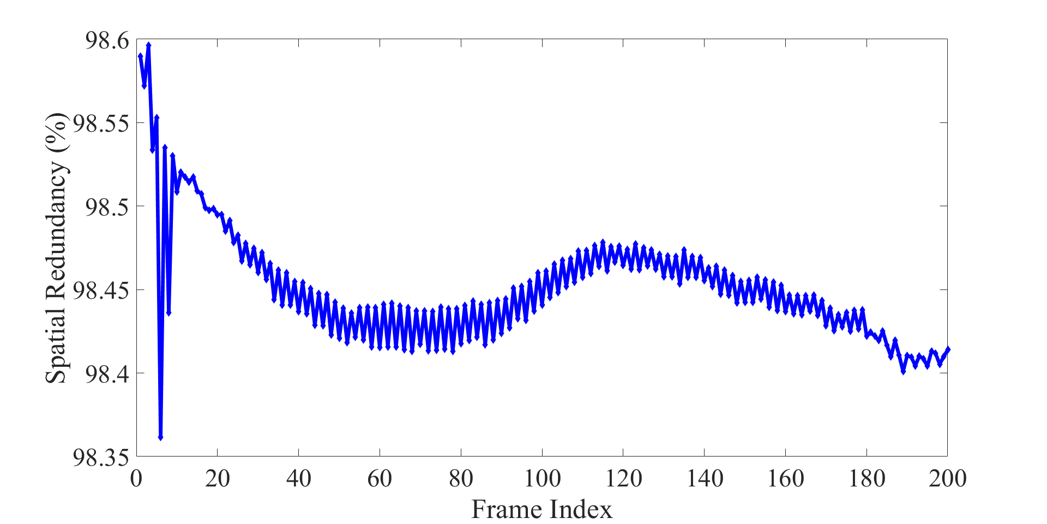
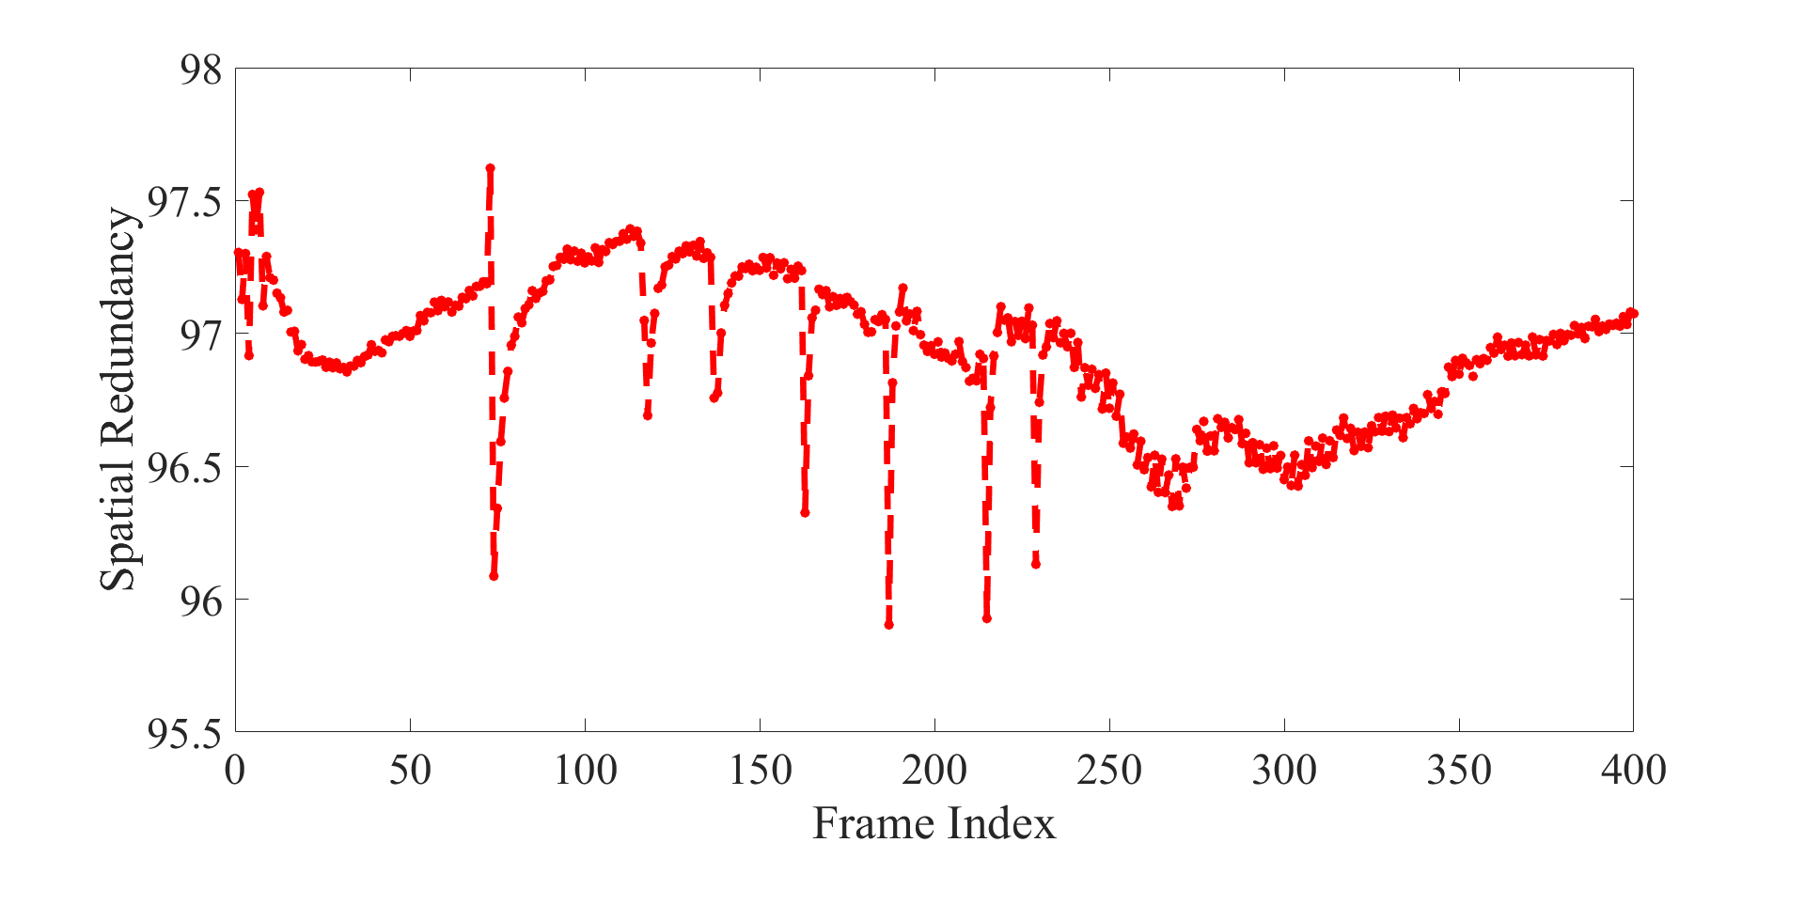
Video Features (Spatial Redundancy)
one dominant object
2 dominant objects
Spatial Locality = 1 - (I-frame size/raw frame size)
Video with 2 dominant objects show
less spatial redundancy than with one object
More variation of spatial redundancy
Notes:
How much Intra-frame redundancy exists?

Slide 31
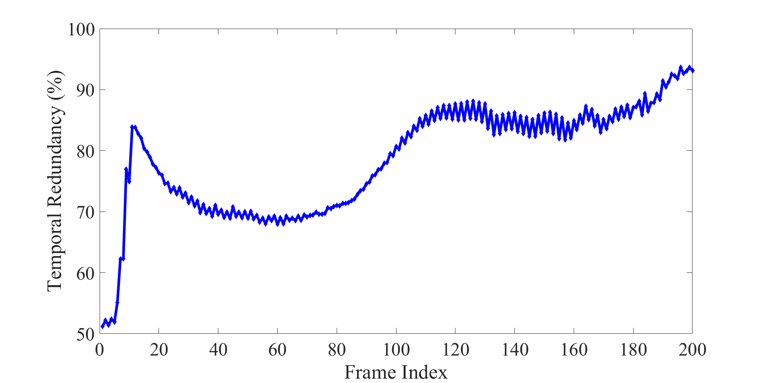
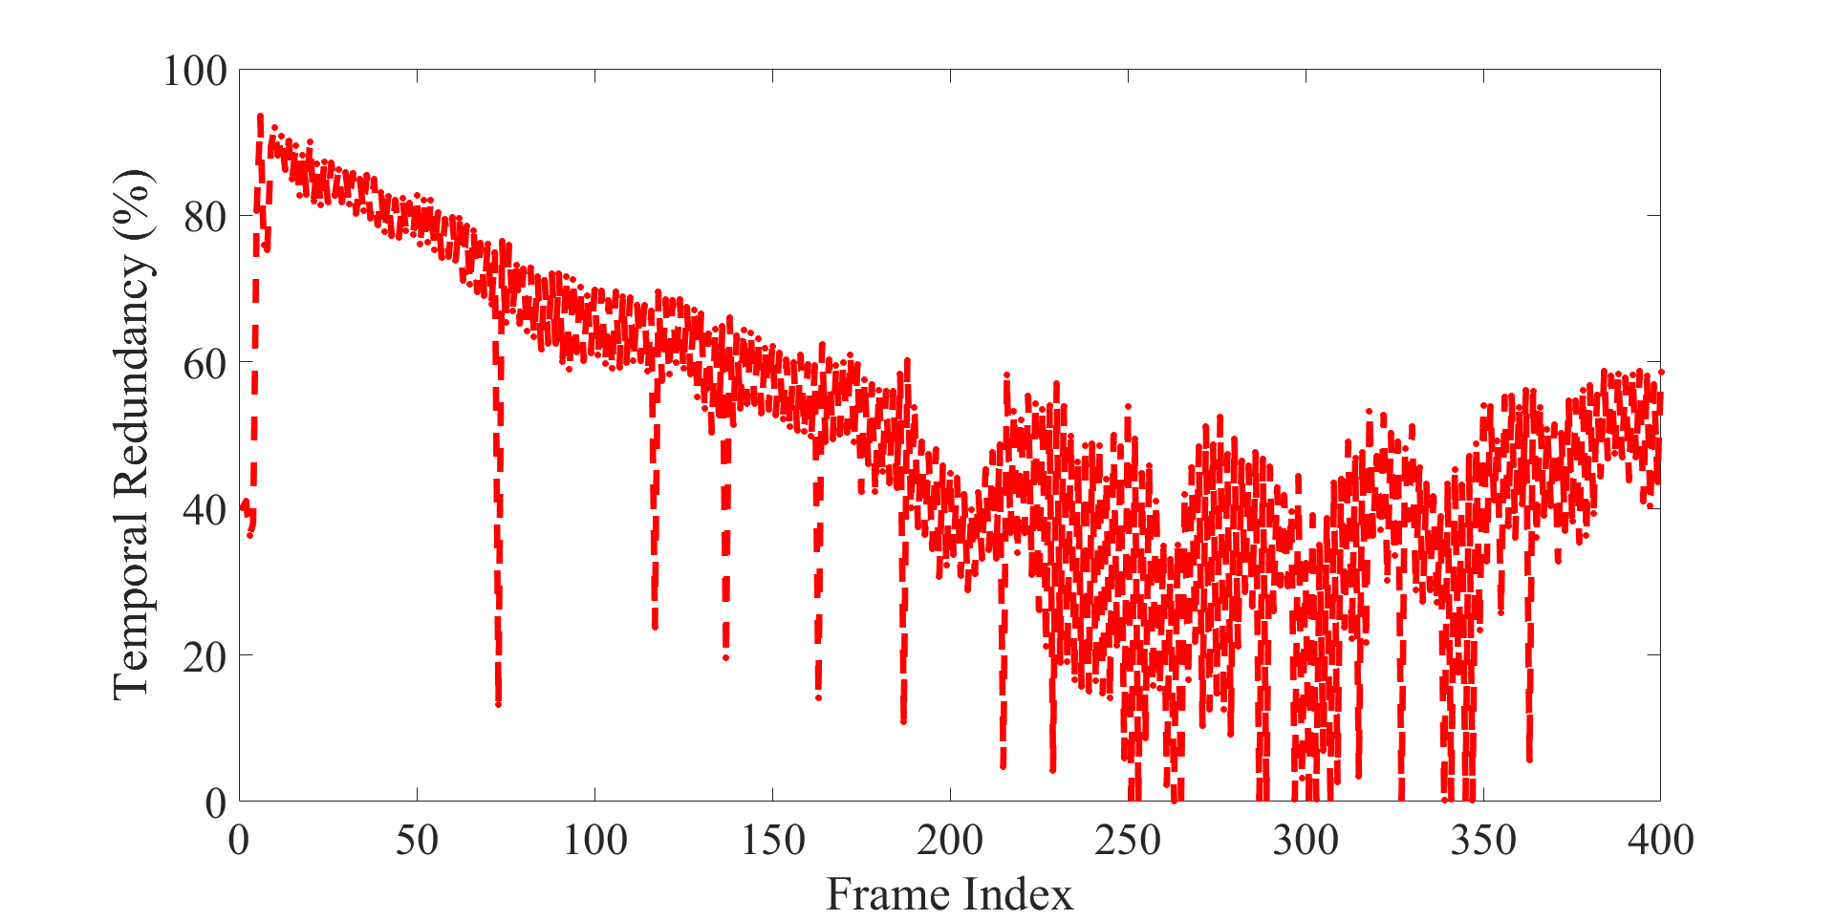
Video Features (Temporal Locality)
one dominant object
2 dominant objects
Encode the (i+1)^{th} frame w.r.to i^{th} frame using H.264 encoder
Temporal Redundancy = 1 - (P-frame size of (i+1)^{th} frame ) / (I-frame size of (i+1)^{th} frame )
Video with 2 dominant objects show
Higher mobility or higher variation in temporal locality

Slide 32
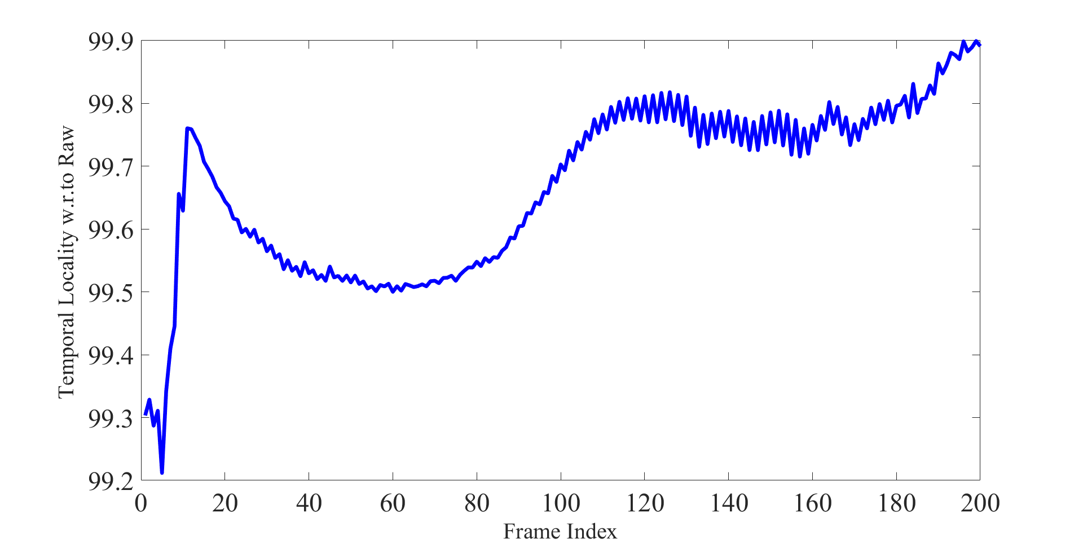
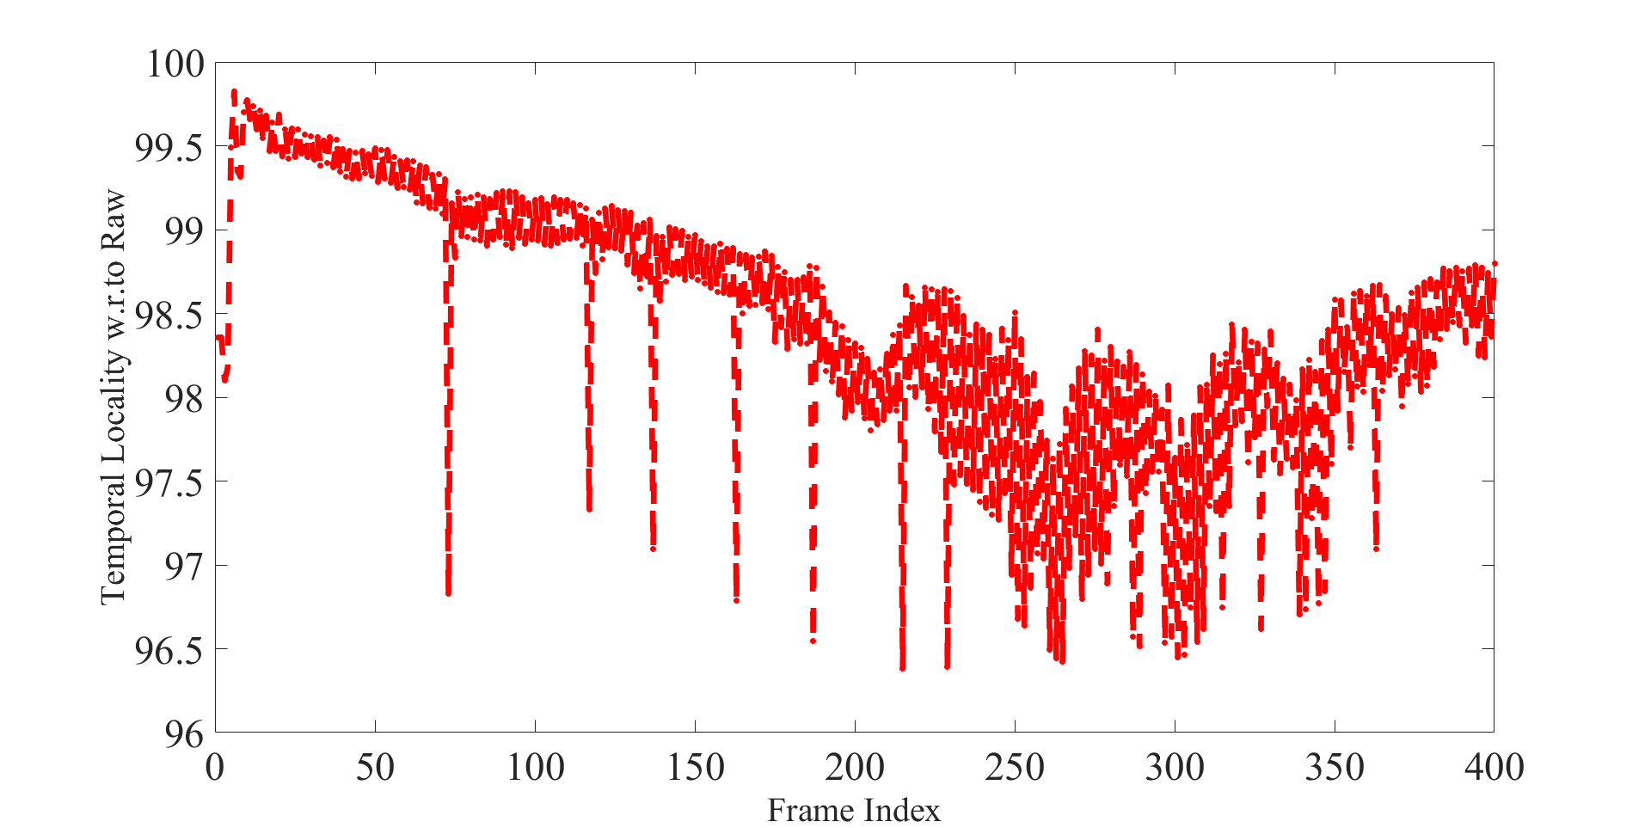
Video Features (Temporal Locality w.r.to Raw)
Temporal redundancy = 1-(P-frame size/ Raw frame size)

Slide 33
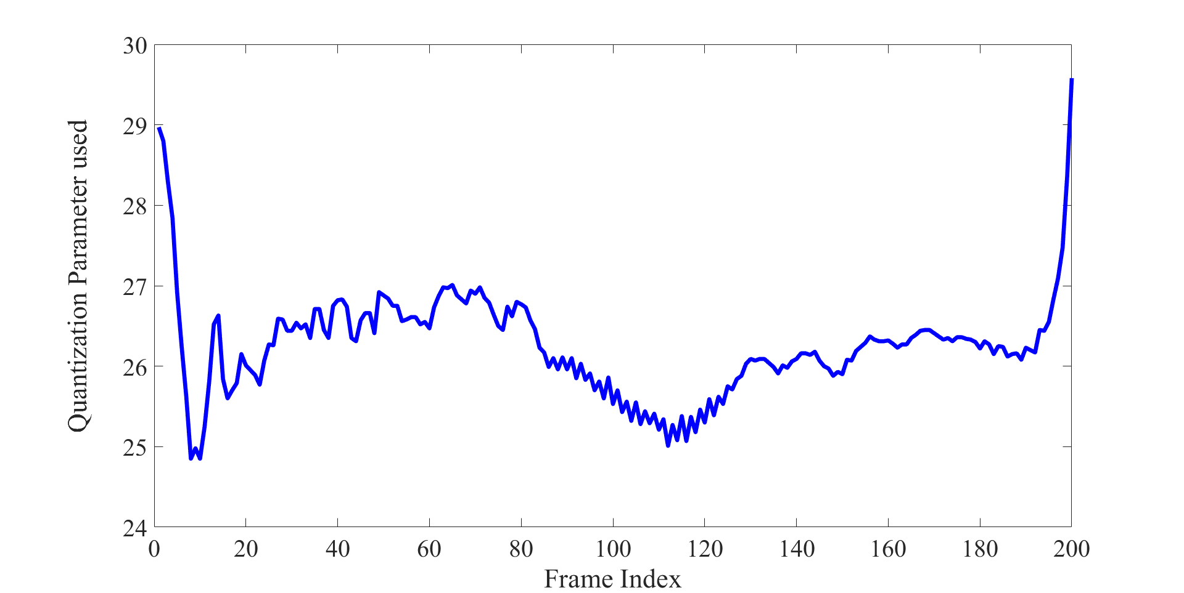
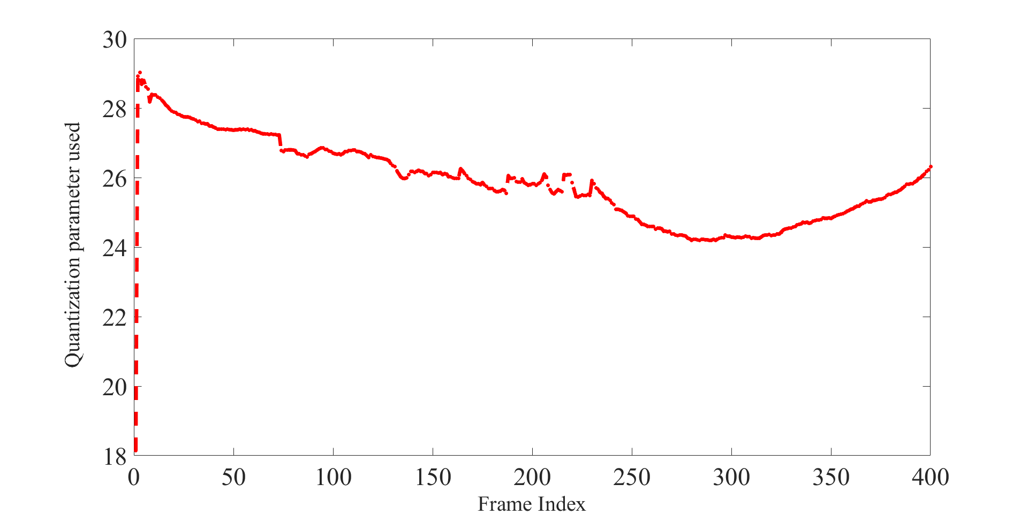
Video Features (QP used in CRF)
Constant Rate Factor Mode will
Increase QP for high motion frames (compressing them more)
lower it down for low motion parts of the sequence
Essentially change the bitrate allocation over time

Slide 34
Expectations
Sudden change in Temporal locality indicates new object appearance or disappearance from the frame
Under this condition,
If spatial locality increases (only background exists)
Dominant object got disappeared
If spatial locality decreases
Another Dominant object appeared

Slide 35
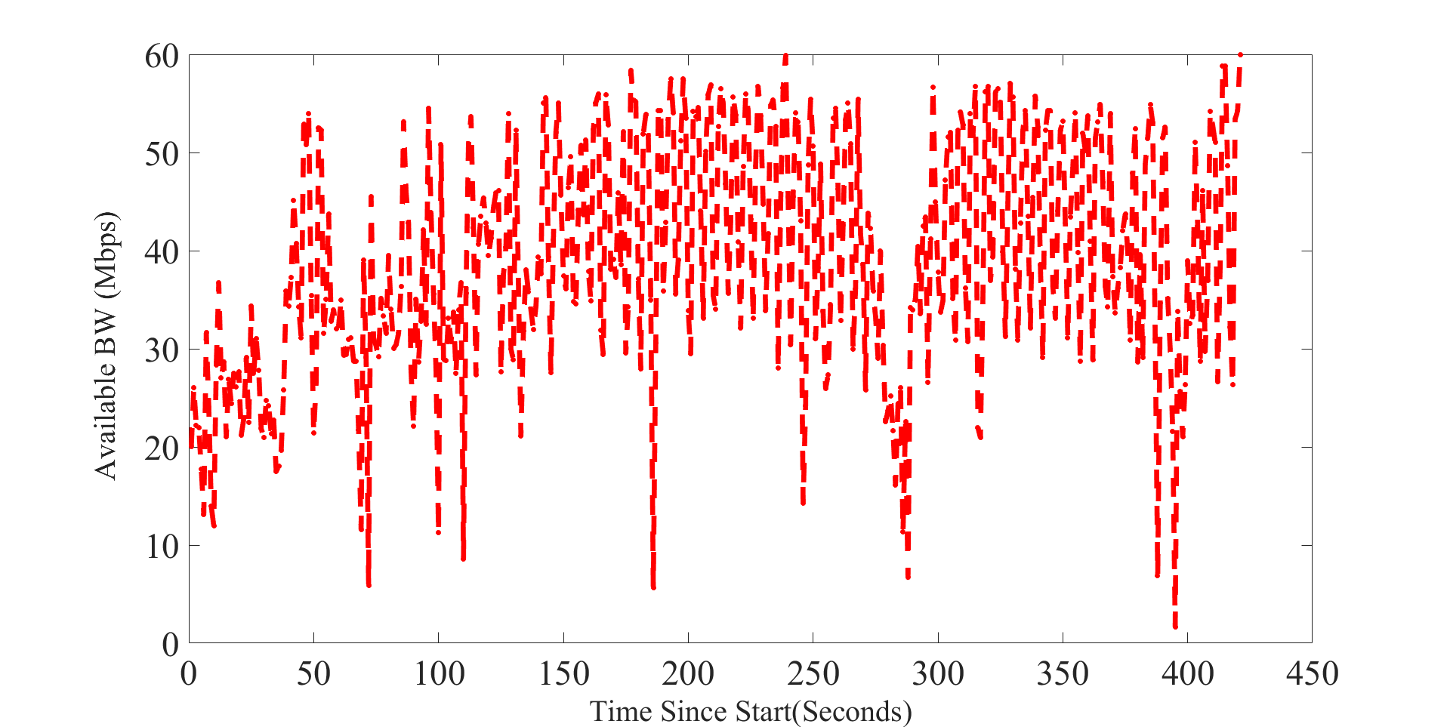
LTE Transmission BW
4G/LTE available bandwidth under walking condition
BW varies around 20-40 Mbps
Maximum BW can be around 80 Mbps
For further experiments, we considered
available BW set = {20, 40, 60, 80} Mbps
Dataset- https://users.ugent.be/~jvdrhoof/dataset-4g/

Slide 36
Experimental Setup
Object Detection Model used – Yolov3
75 cnn-layers + 31 other layers = 106 layers
Latency Constraint ~ 100 ms (Drone Camera Object Detection)
On Edge server, execution of Yolov3 takes ~ 25-30 ms
Hence for Transmission we have 70-75 ms time constraint
First we find out maximum possible
Downscaling parameter
PNG (lossless)
JPEG (lossy)
Quantization Parameter
Frequency of sending raw frames
that satisfy the transmission time requirement under different network conditions.
Network latency constitutes 75% of the total latency

Slide 37
1-Dominant Obj video
2-Dominant Obj video
Under different network conditions,
Four different downscaling parameter used
{352, 480, 608, 704}
Four different QP values used
{22, 24, 28, 37}
Under different network conditions,
Four different downscaling parameter used
{352, 480, 608, 704}
Four different QP values used
{20, 25, 29, 35}
Under different network conditions, quantization parameter and downsampling parameter values highly dependent on the available video content

Slide 38
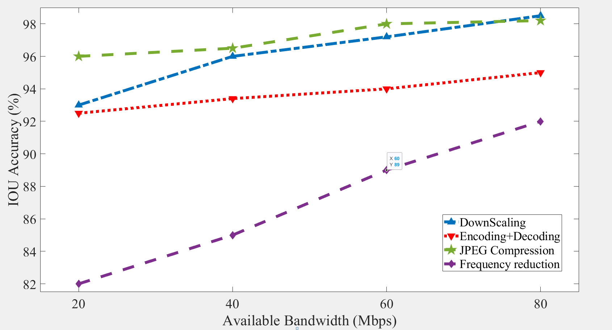
Detecting 1-Dominant Object
one dominant object

Slide 39
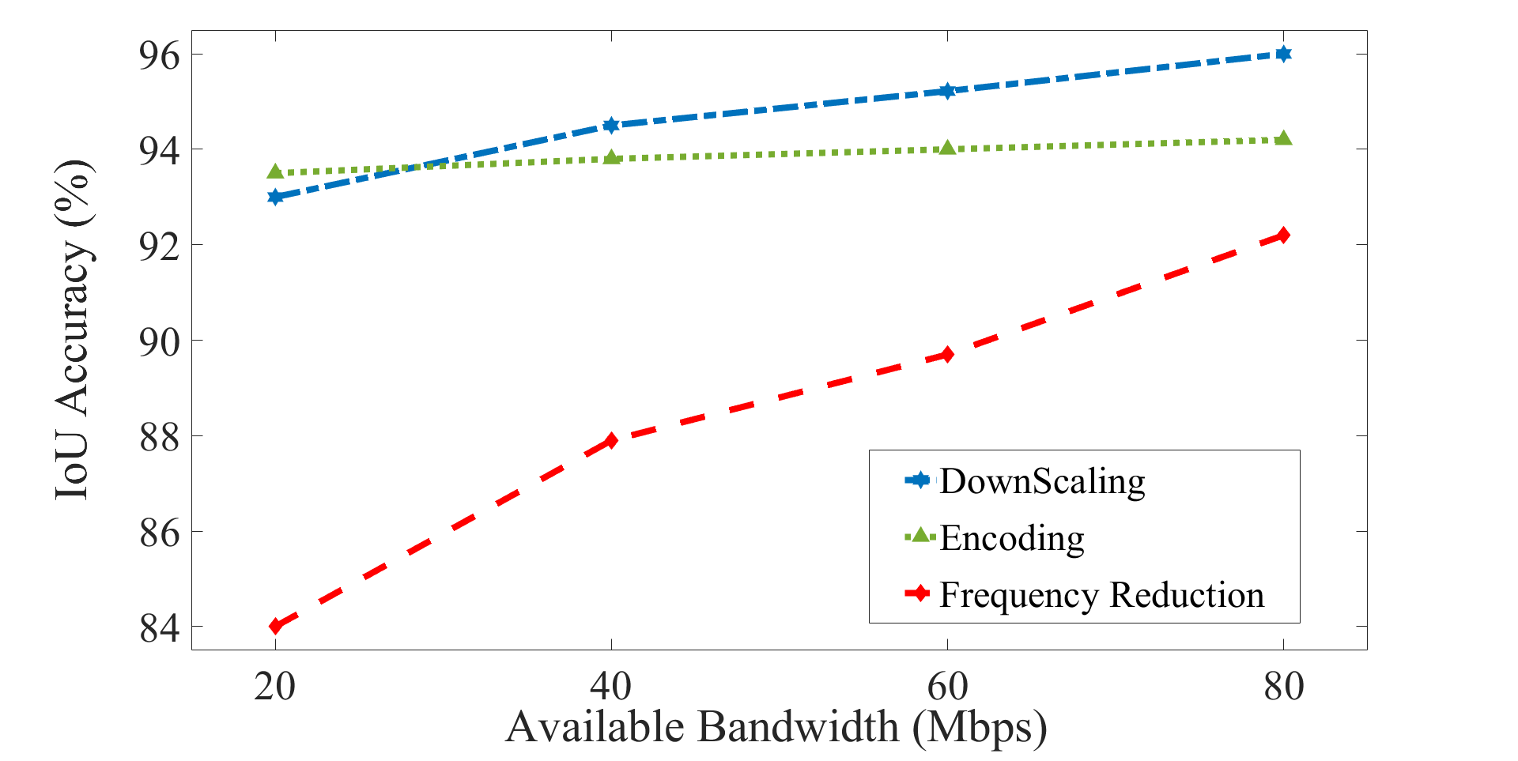
Detecting 2-dominant objects
Why the variation while changing the downscaling parameter or QP for encoding is less?
The initial resolution sent first convolution layer is 416X416 by default. Hence all images downscaled hugely
2 dominant objects

Slide 40
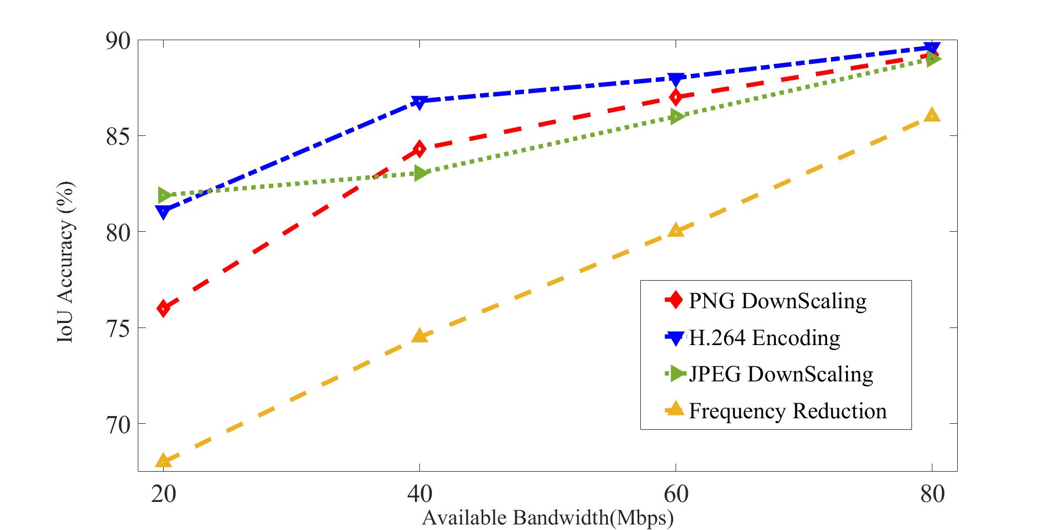
Changing the Resolution before first Convolution Layer (1024)
Observation 1: Increasing the resolution of the image passing through the first convolution layer of CNN broaden the performance gap differences among various methods
Observation 2: For lower available bandwidth ranges the performance gap much higher compared to the higher available bandwidth ranges
(except for JPEG lossy compression)
Notes:
For 60 Mbps, the downscale parameter = 672 and for 80 Mbps its 768.
This differences much higher in the lower bandwidth ranges
With 1K avg obj detection per frame increased to 3 from 1.1

Slide 41
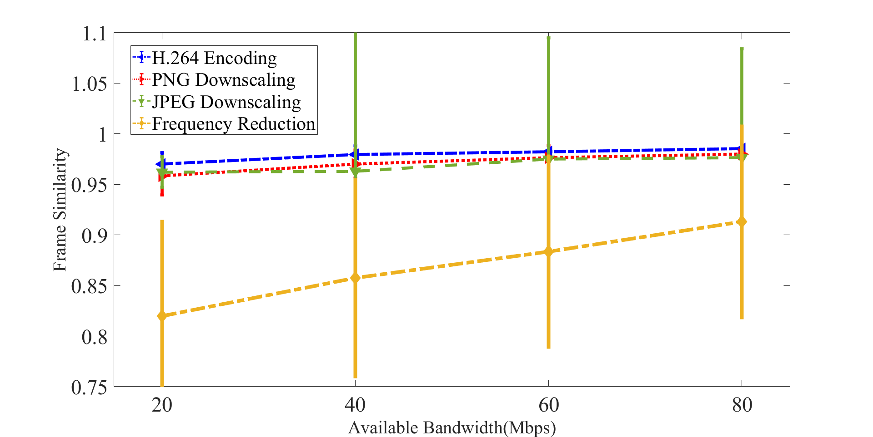
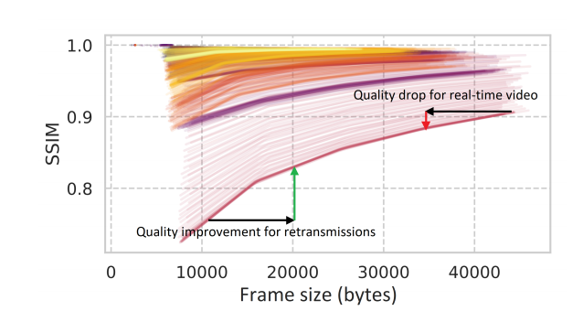
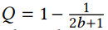
Frame Similarity degradation
SSIM between the original raw frame and the processed frame passed through the object detection pipeline on server
SSIM (Q) as a function of frame size (b), a concave non-decreasing function
Taken from Vantage: Optimizing video upload for time-shifted viewing of social live streams [sigcomm’19]

Slide 42
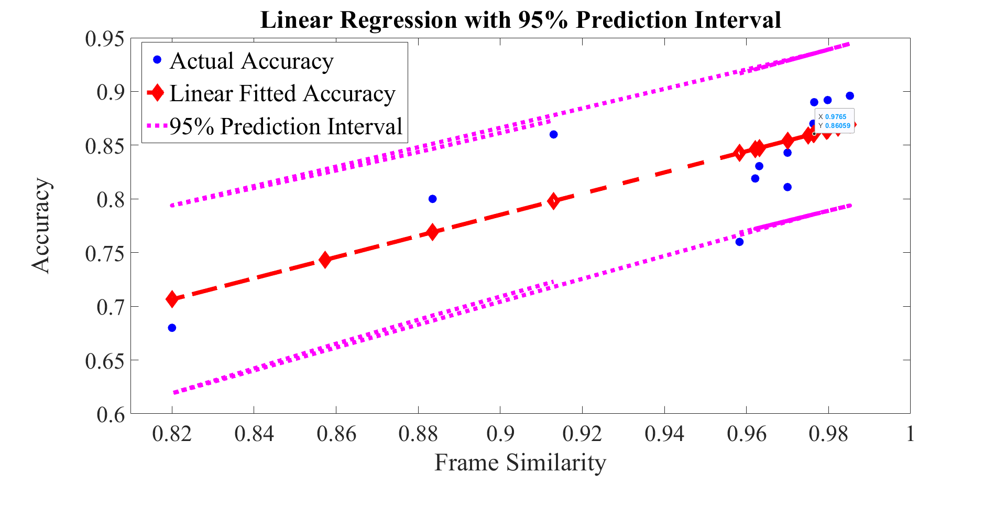
Accuracy vs Frame Similarity (Estimation)
If half of the dataset chosen as estimation and rest is for evaluation
RMS error – 0.0726 (7%)
Regression error : 0.038

Slide 43
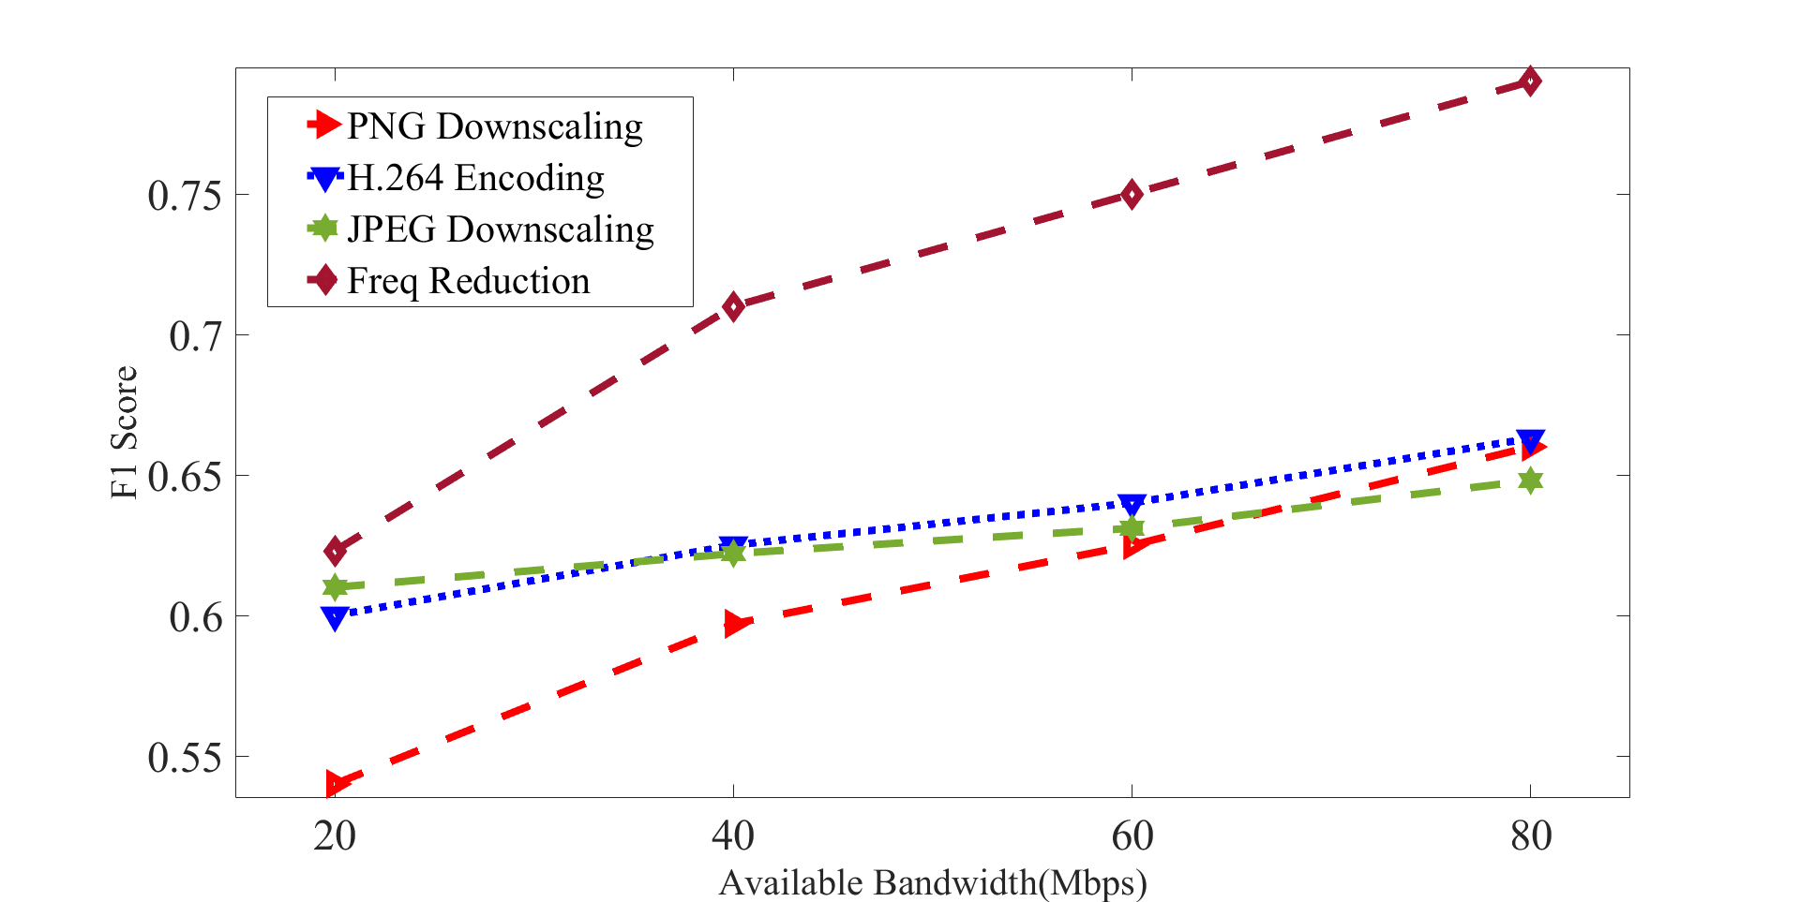
Using Smaller Models (Tiny-YOLO)
Relatively smaller models are more sensitive to change in
content compression algorithms
Parameter selection
Under Frequency reduction
Recall is much higher
Precision is much lower
Compared to other schemes
Which scheme will work best not only dependent on the network bandwidth but also dependent on the model being used by the edge server
Notes:
Suboptimality can be present while switching from one mechanism or from one parameter of one mechanism to another with the sudden change in BW but less resource will be wasted as those are lightweight processes.

Slide 44
Modified Problem Formulation I
Time threshold is fixed and for a particular model on powerful server has very less fluctuation
One can consider the upper bound of detection time (T_{det})
Hence there is fixed budget for communication (T_{comm})
Our transmission frame size < T_{comm} * BW
BW is variable depending on network condition
Send maximal size frame always
Assumption: with higher size (more content) the CNN accuracy will also improve
Is it true always?
No → Adascale [sysML’19]
More content doesn’t imply all are useful.
But is it outliers?
Notes:
After talking with prof (modified idea)

Slide 45
Modified Problem Formulation II
But we can’t directly set the size of transmitted frame/video
Need to set Downsizing parameter, QP in encoding, Frequency of sending frames which in turn restrict the transmission size less than allowable limit
Apply Lightweight ML (in pre-execution step) in order to select best possible parameter or input for CNN detection?

Slide 46
Modified Idea
Notes:
(Talking with Mengwei)

Slide 47
Problem with choosing Alg, then parameter??
Previous papers talk about the choosing best possible tuning parameter (which can be infinite)
# of algorithms (encoding-decoding, freq reduction) are much less hence easier to explore
But they will interplay with each other finding the best QP value after choosing encoding can perform worse than downsizing parameter in downscaling
Finding algorithm and best parameter inside algorithm are not independent events
Combination of algorithms are possible.
Hence we need to consider them jointly
One model (reinforcement learning) decides which algorithms to choose and what will the hyperparameter value
Since ML is end-2-end, using ML for end-2-end solution will be much better

Slide 48
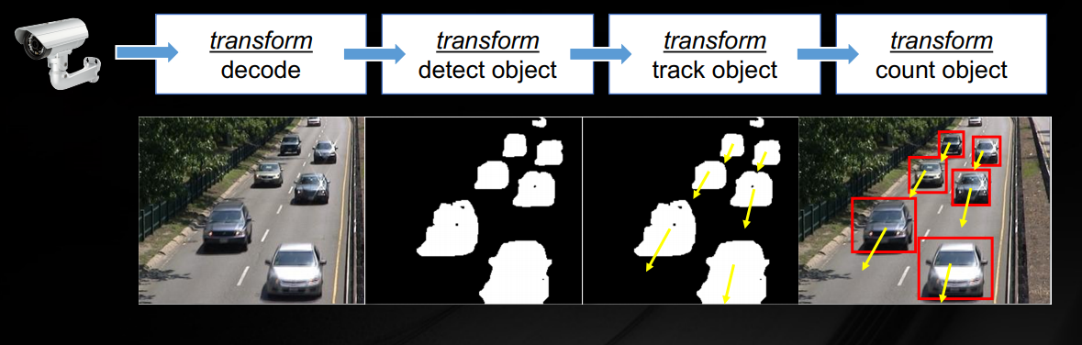
Video Analytics Pipeline
Existing work considers fixed detection classification pipelines which incorporates different modules like decoder, obj classifier

Slide 49
Fixed(few modules) vs Flexible (numerous Ops)
Previous work has fixed video analytics pipeline, once deployed executed for ever
Previous works don’t consider how different preprocessing algorithms on client and server side along with the model used for detection can be visualized as a flexible pipeline
Each operators of this flexible pipeline can be turned on/off (Boolean)
Each ops in the pipeline can be tuned in a content aware way to find the best possible accuracy under deadline (Continuous)

Slide 50
Flexible Pipeline of Operators
Client Side
Server Side
OP₁
OP₂
OP₃
OP_{N-1}
OP_{N}

Slide 51
Impact of These Operators
Client Side (OP_{client})
T_{t} + T_{c} < T_{threshold}
Server Side (OP_{server})
Computation Time, T_{c}
Input
Image
ML model
OP₁, OP₂, OP₃, ….
OP_{N}
Transmission Time, T_{t}
Few operators will change the transmission time (Op_{client})
Few operators will change the computation time (op_{server)}
Any change in this operators can change in accuracy

Slide 52
What are these Operators?
OP_{client} includes
Downsizing (OP₁), Encoding (OP₂) , Freq reduction (OP₃)
OP_{server includes}
Which model to choose (OP₄)
Any existing algorithm (likewise DeepMon, DeepCache) can also be considered as one operator and our modified ML model will choose whether to select those operators or not.

Slide 53
Pipeline of Operators (Explored)
Order of the operators is fixed
Client Side
Server Side
Computation Time
OP₁
OP₂
OP₃
OP₄
OP₅
Transmission Time
Downsizing
JPEG compression
H.264 encoding
Freq reduction
Model Selection
Downsizing parameter
Yes/No
Frequency value
Different Models
QP

Slide 54
Plans to procced
Extensive simulation in order to find the ground-truth
List all the video features (search more on CVPR)
Feed them into regression model
Find out what video features are useful
One generalized model will decide all operators
Reinforcement learning (Read Sigcomm papers to observe how they apply)

Slide 55
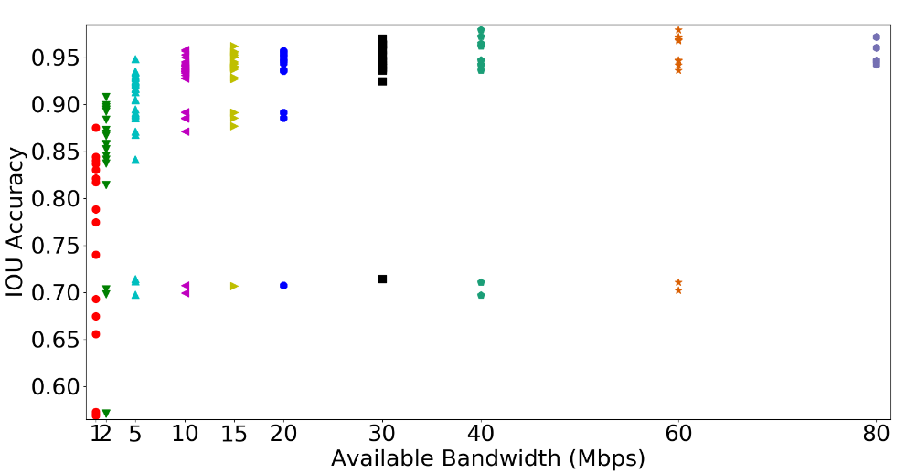
Accuracy vs Available BW
186 different configurations are plotted
Each configurations resulted different outcomes
For example, best configuration for bandwidth 5 under those 3 operators
Downsize image by 960
JPEG compression
Encode with QP 28
Best configuration doesn’t correspond to maximum size.
Sometimes it less than the mean of sizes available across all configurations
Notes:
For bw 20, best configuration downsize 960 no jpeg and encode with qp 12

Slide 56
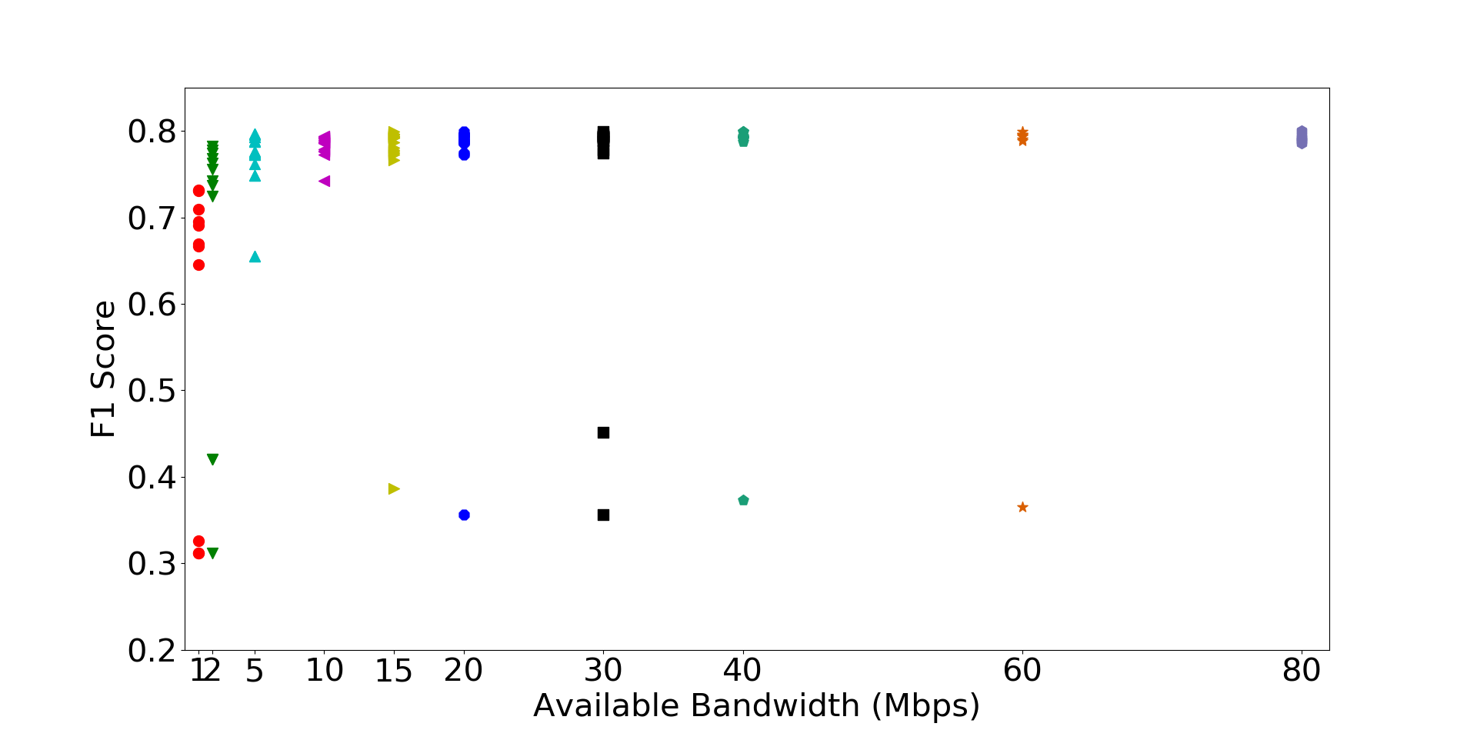
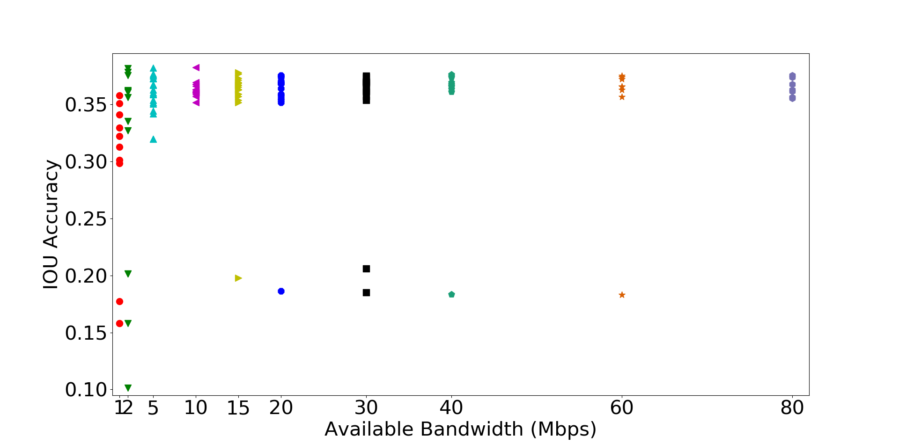
Accuracy vs Available BW (Different Model)
We use tiny yolo in order to check the effect
Tiny yolo can finish the computation on server 1.67x times faster
Hence we can accommodate larger size pre-processed frames for communication
Notes:
We use F1 score here as bounding box based accuracy is really less for tiny yolo

Slide 57
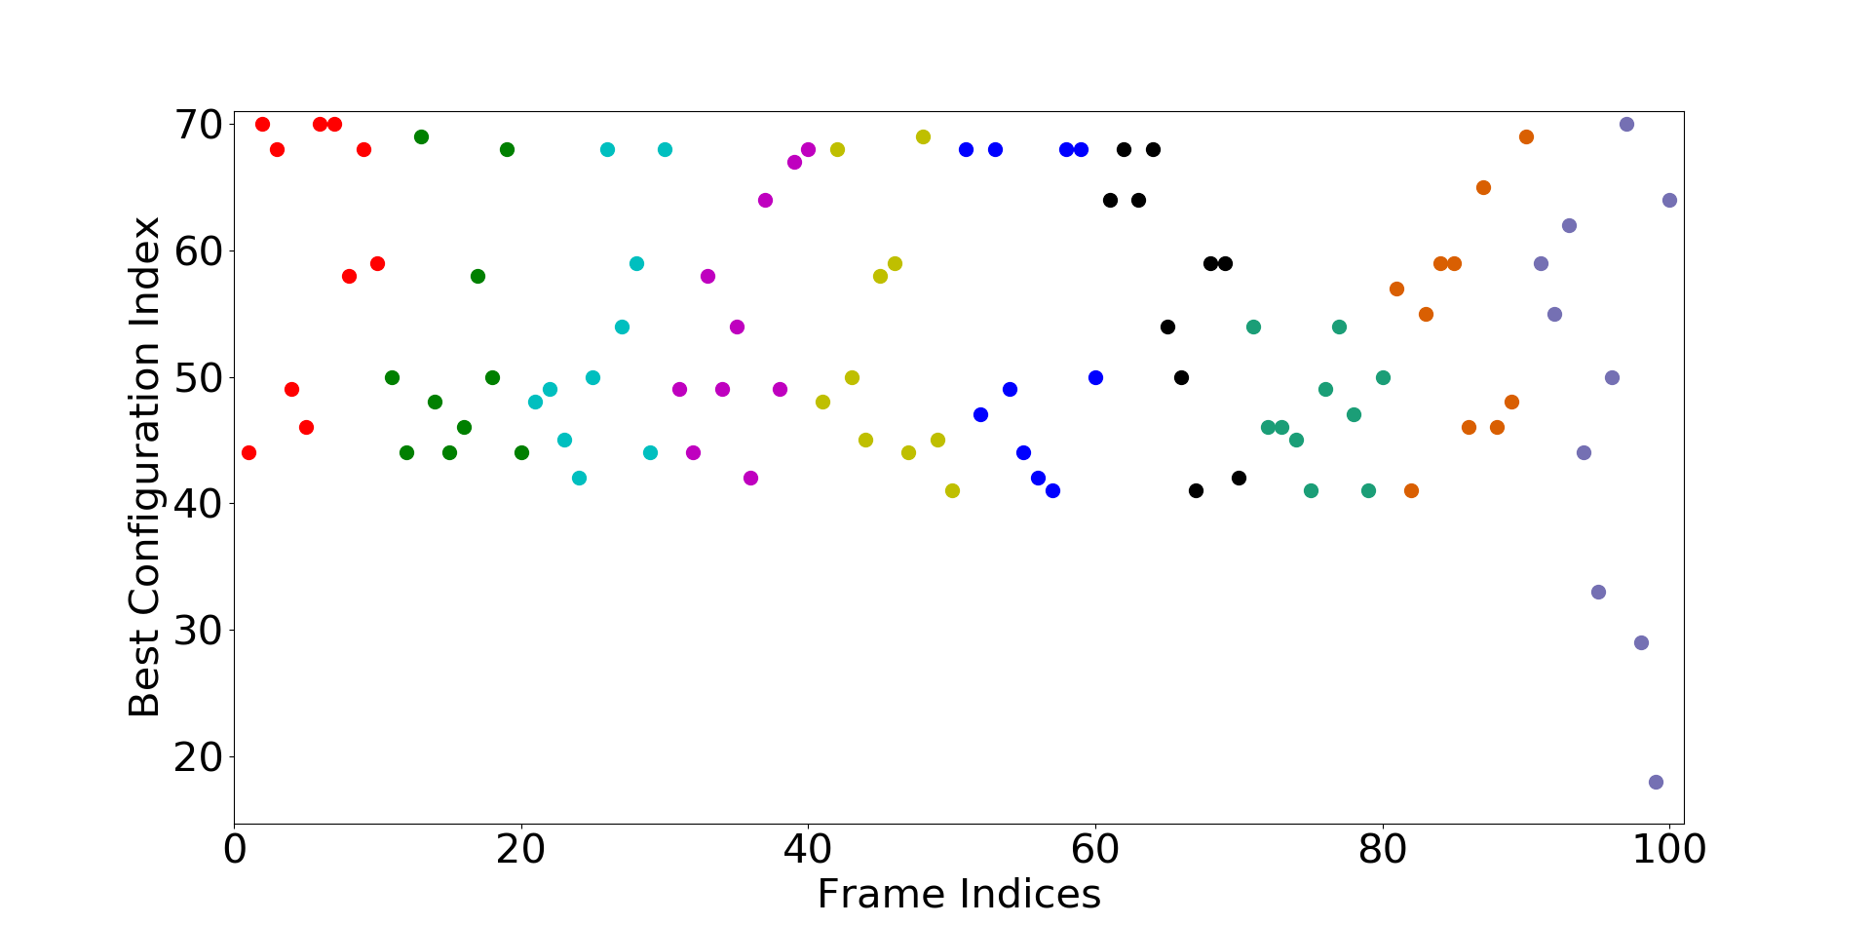
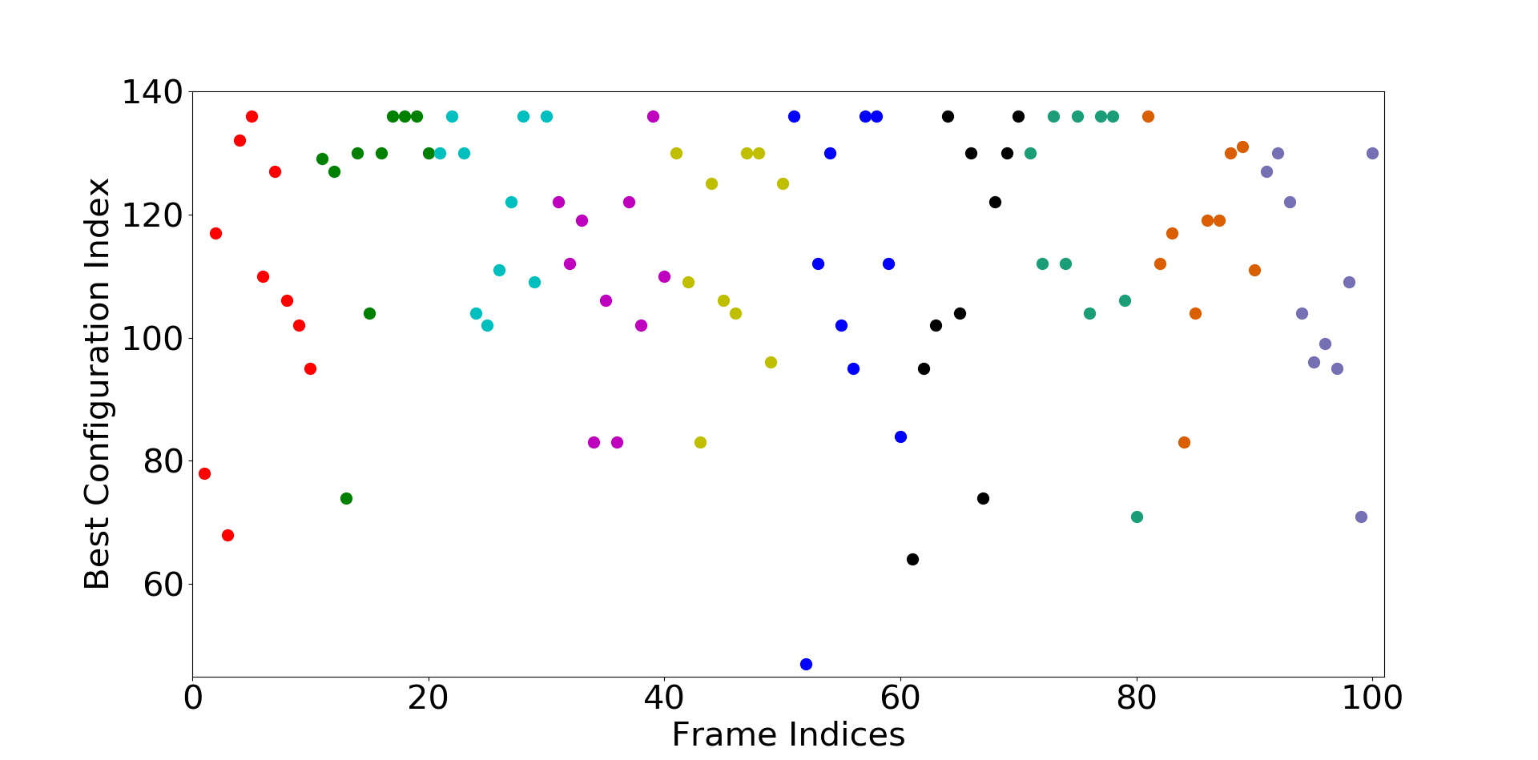
Best Configuration varies over Content
For consecutive frame indices in a video, best configuration also varies for the same network budget
This motivates us to drive the preprocessing in a content-aware way
5 Mbps
20 Mbps

Slide 58
Approximate Parameter Tuning-I
for (i = 0; i<n; i++)
if (i%approx_level == 0)
result = compute_result()
approx_level = 5,
Accuracy degradation → 3% (mean)
approx_level =10,
5.5% (mean)
>13% (stdev)
Fixed approximation level is not good…

Slide 59
Approximate Parameter Tuning-II
for (i = 0; i<n; i++)
if (i%approx_level == 0) && (trigger)
result = compute_result()
Triggering only happens when the previous accuracy degrades a lot
approx_level =10,
3% (mean)
>8% (stdev)

Slide 60
Approximate Parameter Tuning-III
for (i = 0; i<n; i++)
if (trigger)
result = compute_result()
Triggering only happens when the previous accuracy degrades a lot
3.2% (mean)
9% (stdev)
How much degradation is concerning needs to be determined

Slide 61
Approximate Parameter Tuning-IV
for (i = 0; i<n; i++)
result = compute_avg_result(period)
Triggering only happens when the previous accuracy degrades a lot
3.2% (mean)
9% (stdev)
How much degradation is concerning needs to be determined

Slide 62
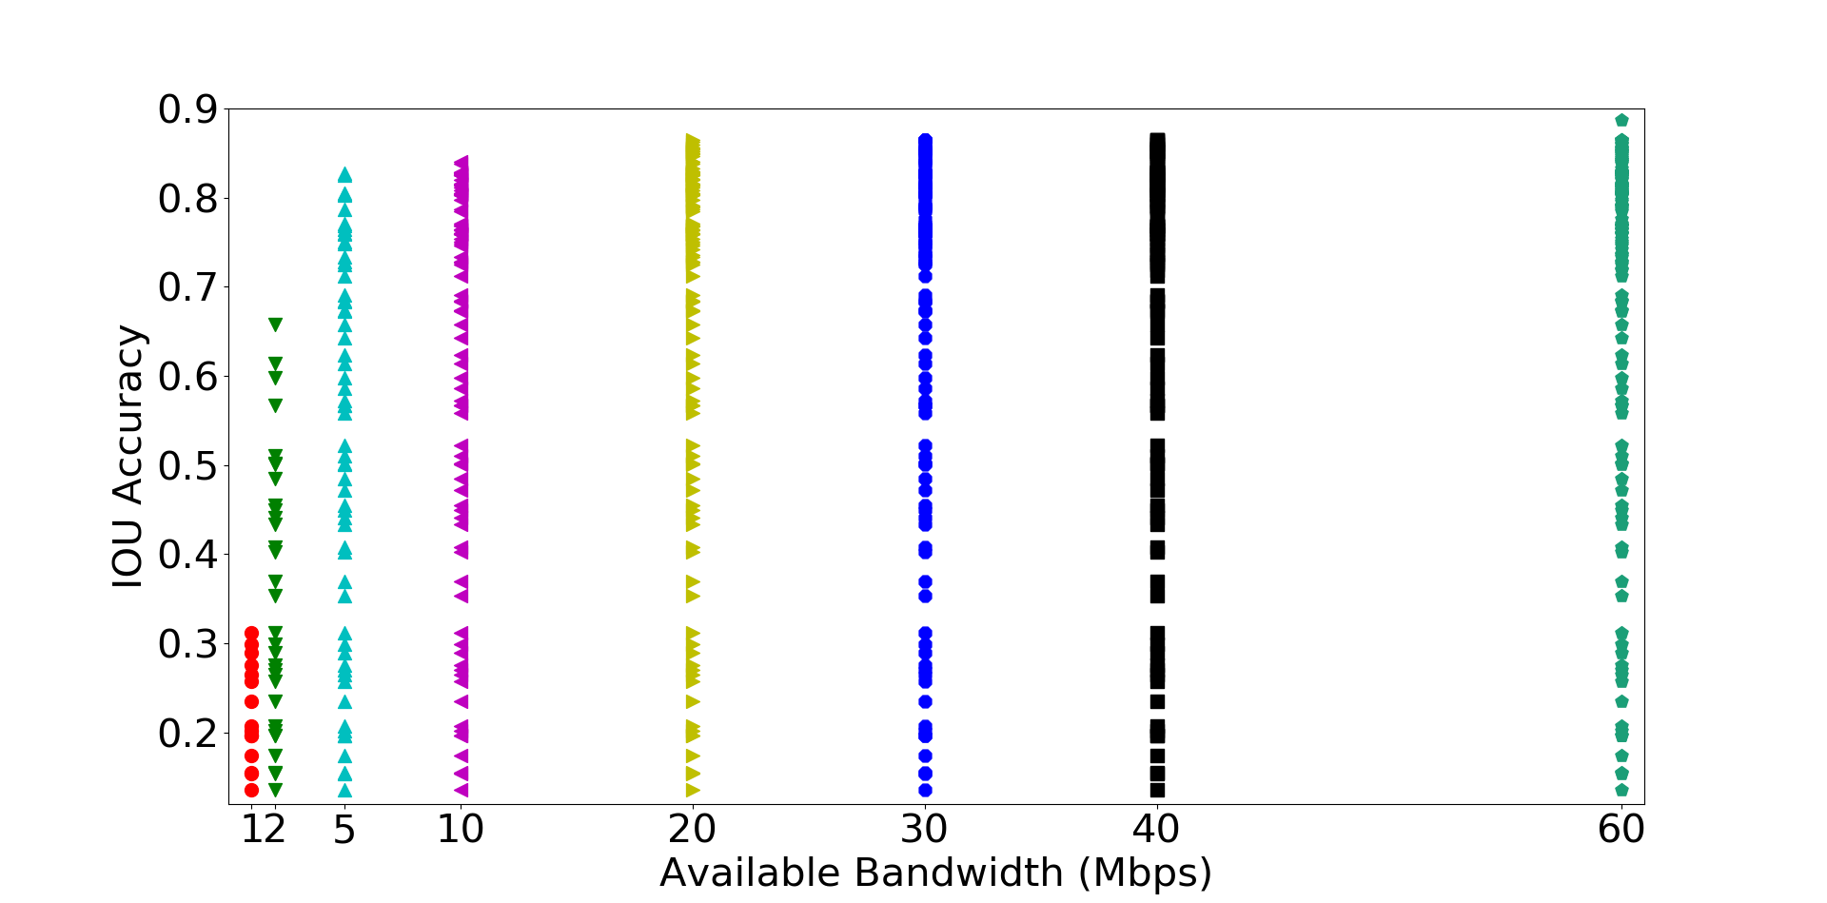
For Drone Captured Images
Accuracy variation over all possible configurations (134) using full YOLO model

Slide 63
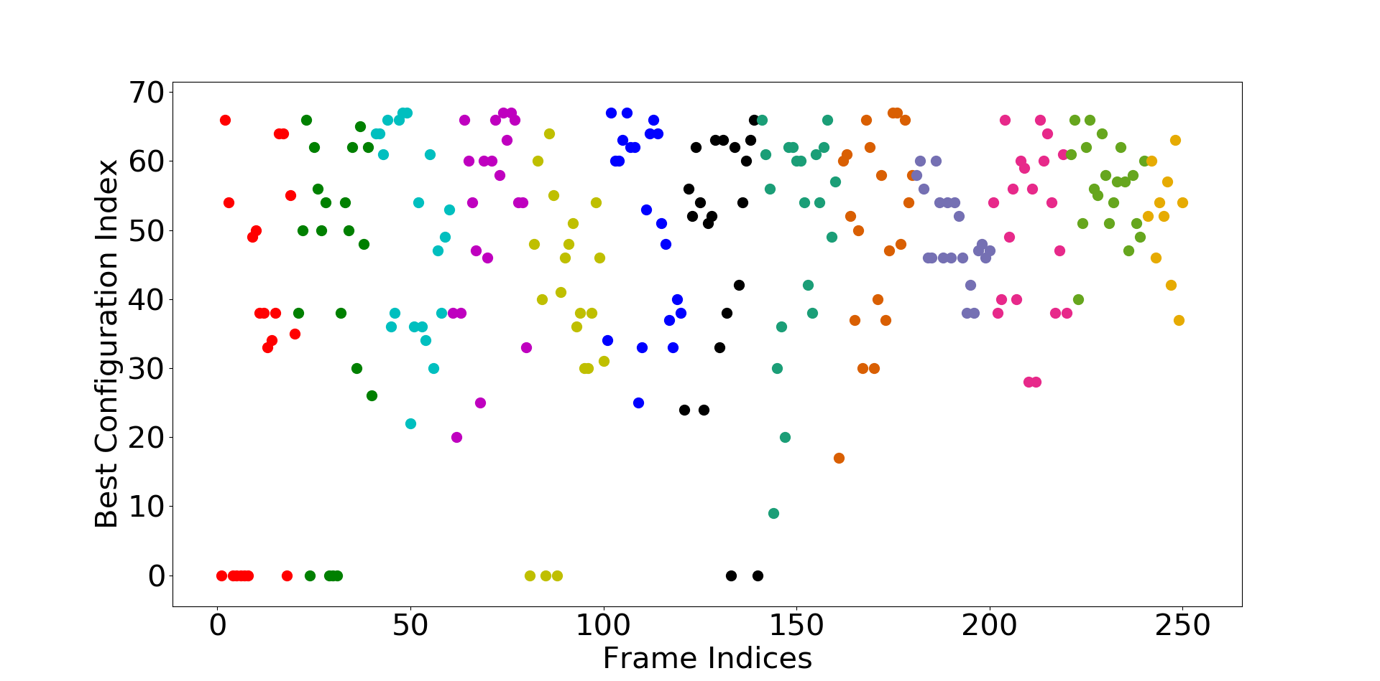
Here also best configuration varies from frame to frame
Only 19 consecutive frames have same configuration over 249 frames

Slide 64
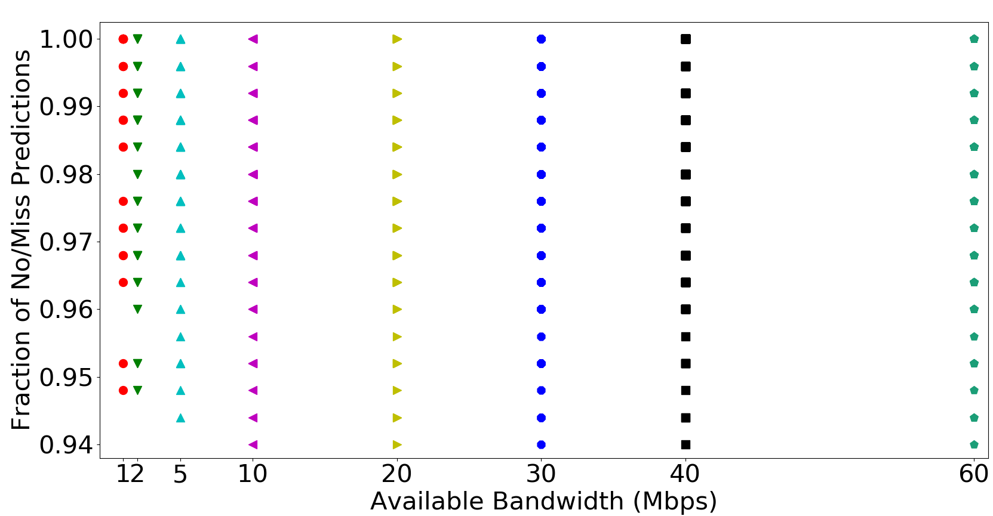
For Drone Captured Images
Use of small model (tiny-yolo) incurs a lot of miss predictions
Almost 94%
Hence, drone captured images requires highly efficient model with high depth for accurate object detection

Slide 65
How to modify the Model depending on Network BW?

Slide 66
In Edge Computing…
Edge servers are highly heterogeneous
Much lower in computational capability compared with cloud servers
Idea is change the Model size according to communication BW constraint

Slide 67
Different Model Resizing
Now Model Resizing can be performed in multiple ways like
Model pruning which has 4 different ways
Quantization
Branchynet
Model Pruning
Neurons
Weights
Layers
Filters

Slide 68
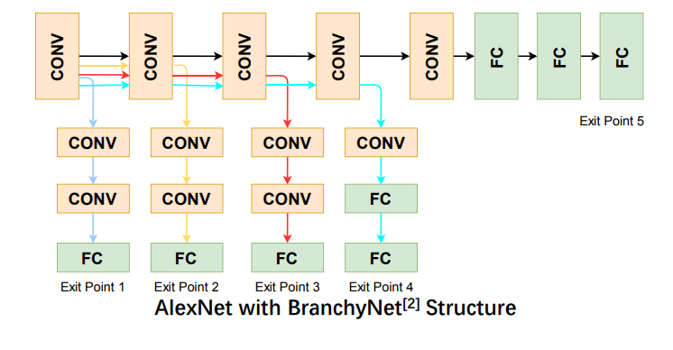
Branchynet
Lots of data points can be classified easily and require less processing
Two hyper-parameters
--earlyexit_thresholds
--earlyexit_lossweights

Slide 69
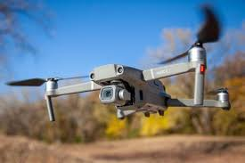
Drone Camera Network
Drones are moving within a range so distances from the edge server will change continuously hence ping-latency will be different at different position

Slide 70
Idea
under variability in the connectivity pattern, its not good to send the entire high-resolution dataset to the edge for processing
Lower size data → bad network connectivity
edge server should use less time to predict so that
more time can be spent on the communication
to meet the deadline for mission-critical applications.

Slide 71
Idea.. Extended
Based on the offloaded datasize level choose one of the multiple models (Branchynet) with meeting the accuracy requirement
Only in complete disruptive scenario, where no internet connection is there, install a proper lightweight model tiny-dronet model to make sufficient/necessary predictions
Notes:
Another important research question, drone battery power as its very restricted so make less computation on edge device here drone?

Slide 72
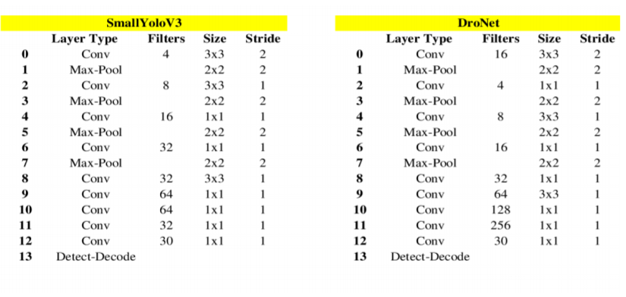
Dronet
Pruning Filters
Will apply the MorphNet to get the optimized filter size for each layer
Notes:
Is there any difference between drone captured images and camera captured images?

Slide 73
Can we prune more?
Replace FC layer with Conv layer
Kernel of the filter reduction
Channel reduction
Evenly add Max-Pool layer (to downsample the size)
Depthwise Seperable conv
Shuffling

Slide 74
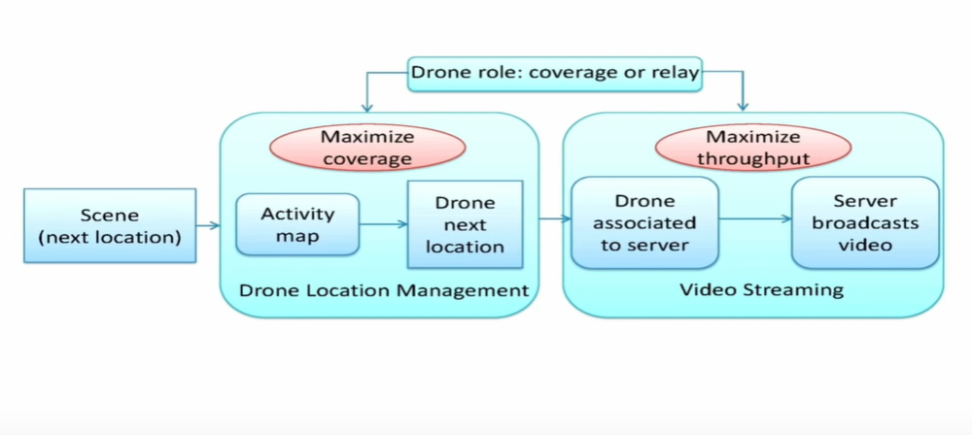
Drone Camera Network: System
Notes:
How to use compressive sensing in object detection?
Video analytics requires lots of datapoints to be processed, but compressive sensing can reduce the # of data points, sparsity ouf the matrix, having prior knowledge

Slide 75
Background extraction
Background extraction can be applied in order to keep track to movement of foreground (also lightweight)
Can only work for fixed camera with moving objects
Can’t work for moving camera as it subtracts the pixels of subsequent frames appeared in BG
Can’t apply for Mobile deep vision or drone camera network as camera is moving all the time

Slide 76
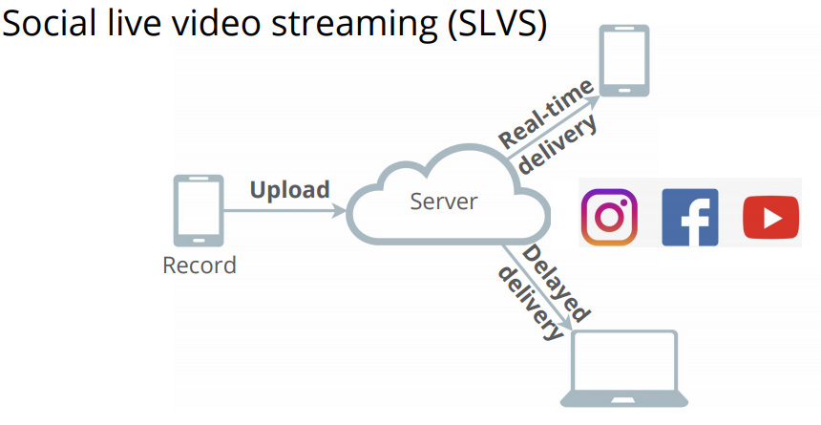
Social Live Video Streaming (SLVS)
In current SLVS approach, download video quality dependent on the uploaded video quality
Rate adaptation
Multiple Viewing delay
Vantage [sigcomm’19] solved this problem
Specific to live video streaming

Slide 77
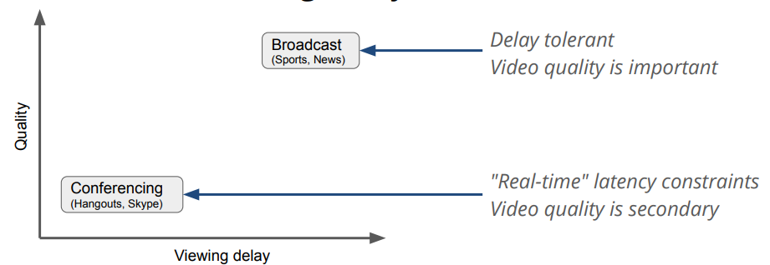
Latency-Video quality Tradeoff
To solve the upload video quality variation under different BW, server can apply GANs to enhance the quality of the received video

Slide 78
Resolution/FPS/Quality
QoE:
Latency
Mobility
Mobile Device
Capability
Wireless Network
Bandwidth

